Slide 1
An Analysis of Career Trajectories: Salary & Experience Across Global Industries
Milestone Project
ALBIN K A
28/04/2025

Slide 2
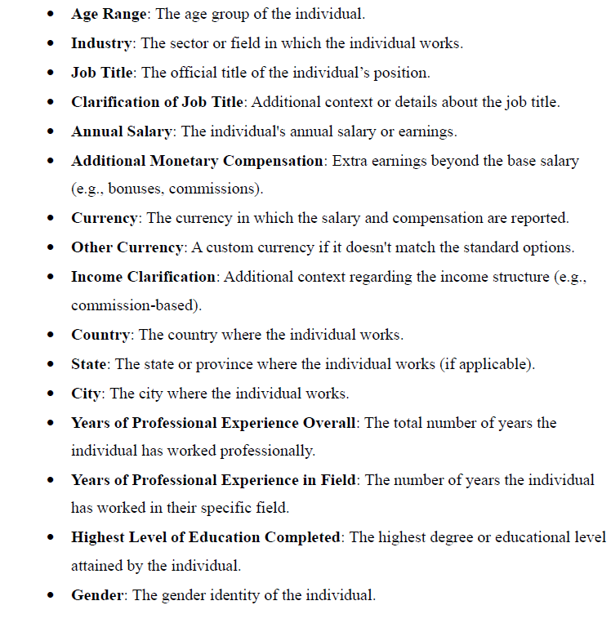
Introduction
In a rapidly evolving global workforce, understanding career trajectories is more important than ever. This analysis offers invaluable insights into salary trends and industry dynamics, empowering professionals and organizations to navigate the complexities of career advancement and workplace equity.
The Salary Survey data set contains several factors, such as

Slide 3
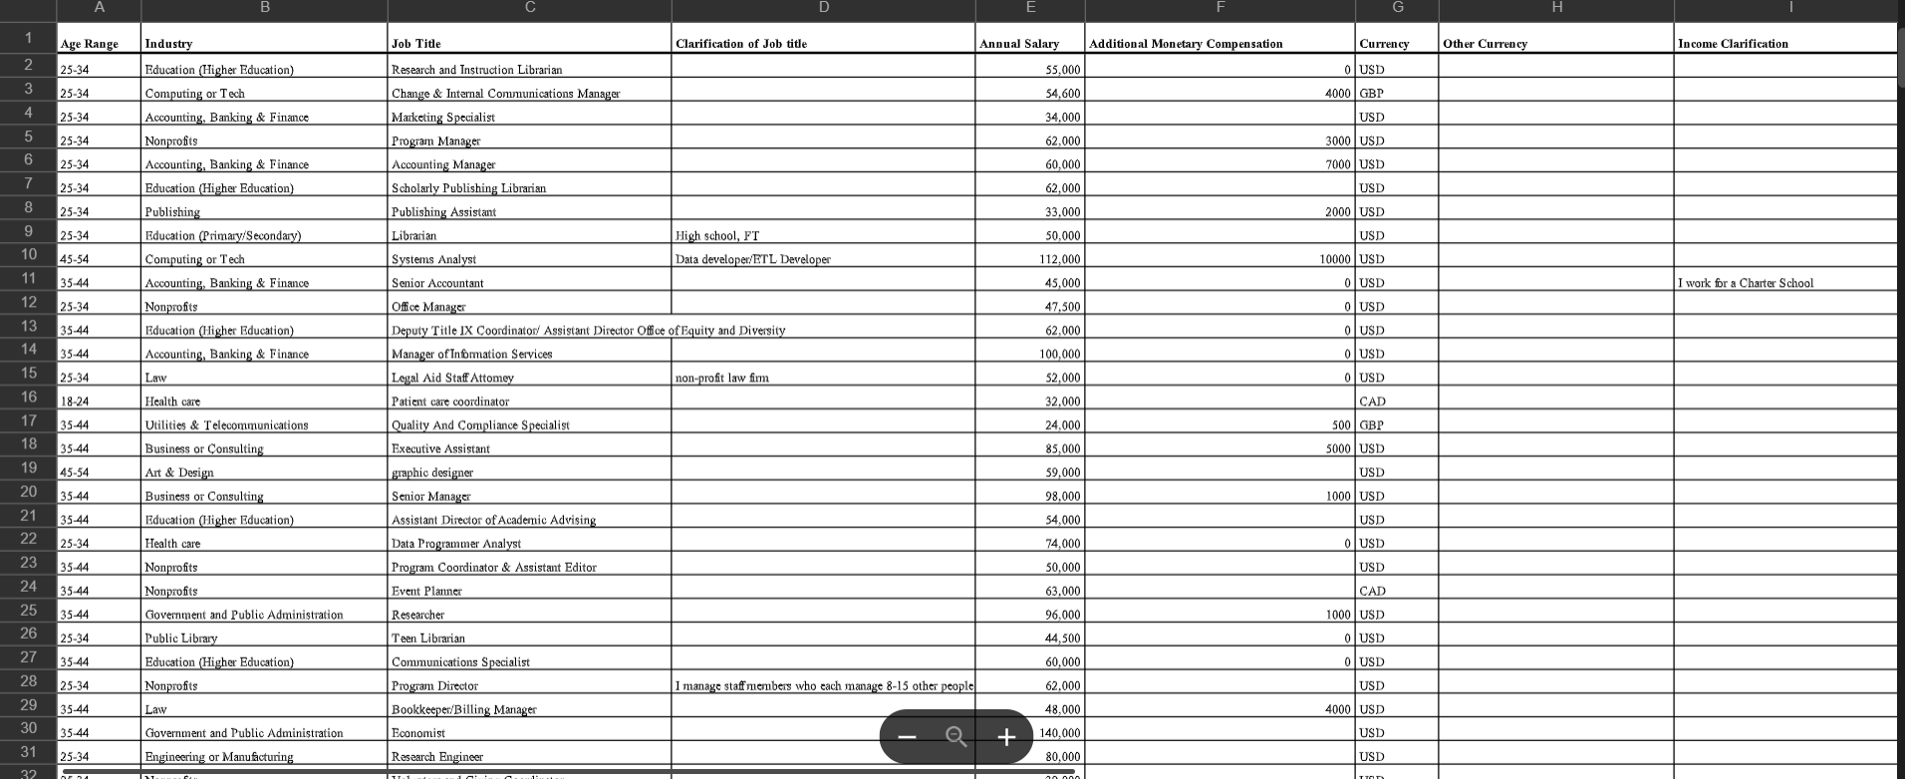
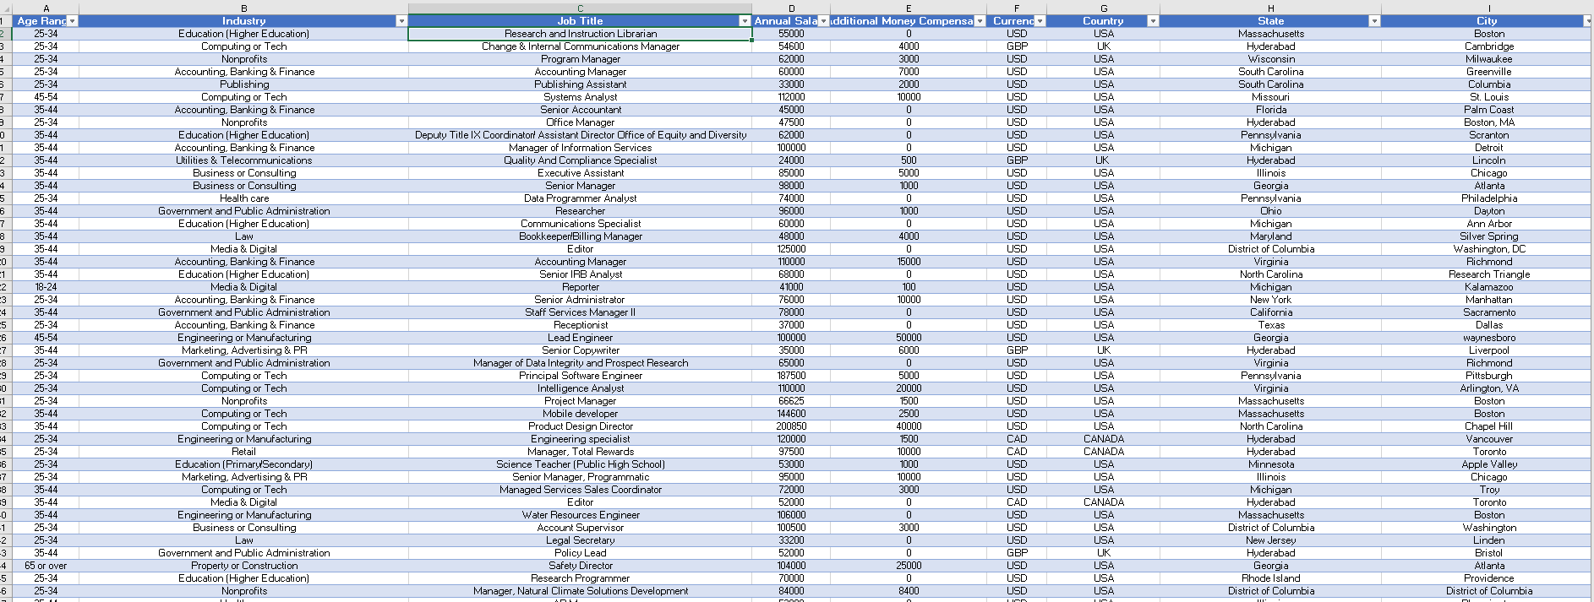
Data cleaning
After cleaning
Before

Slide 4
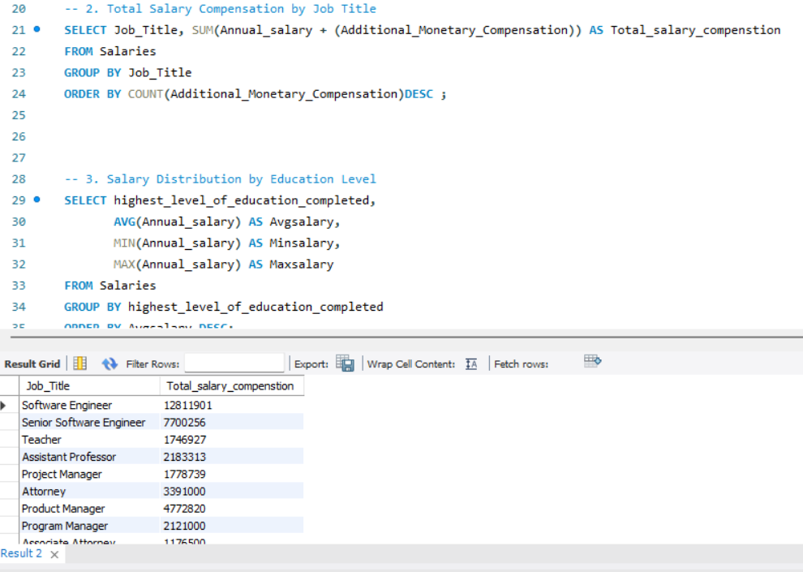
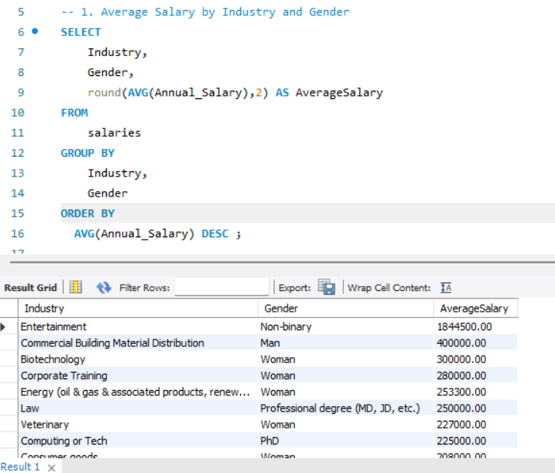
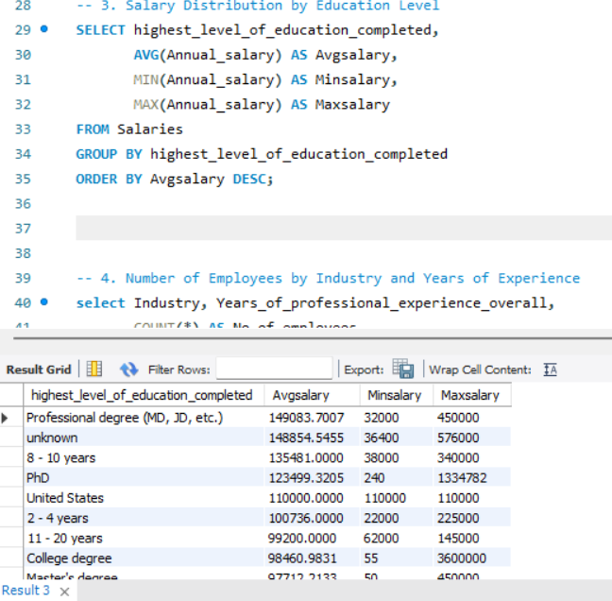
Sql query & output

Slide 5
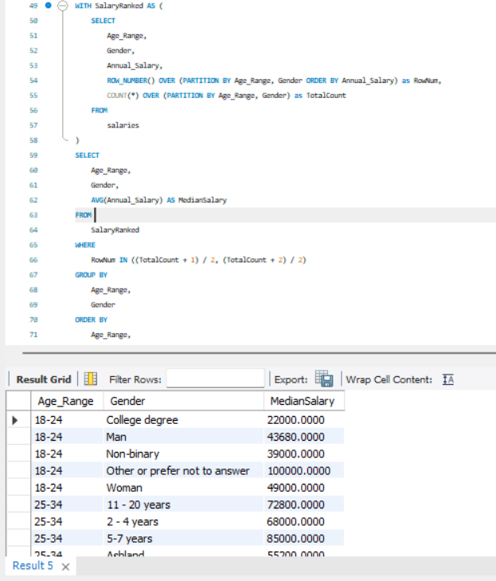
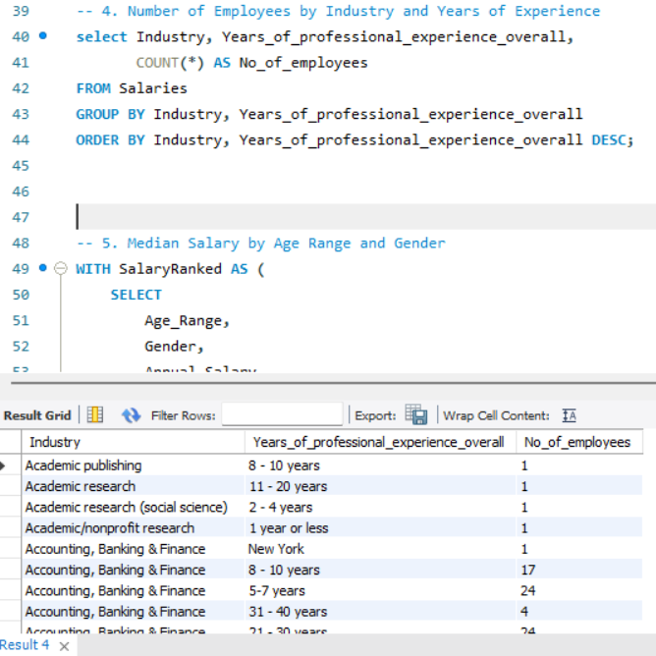

Slide 6
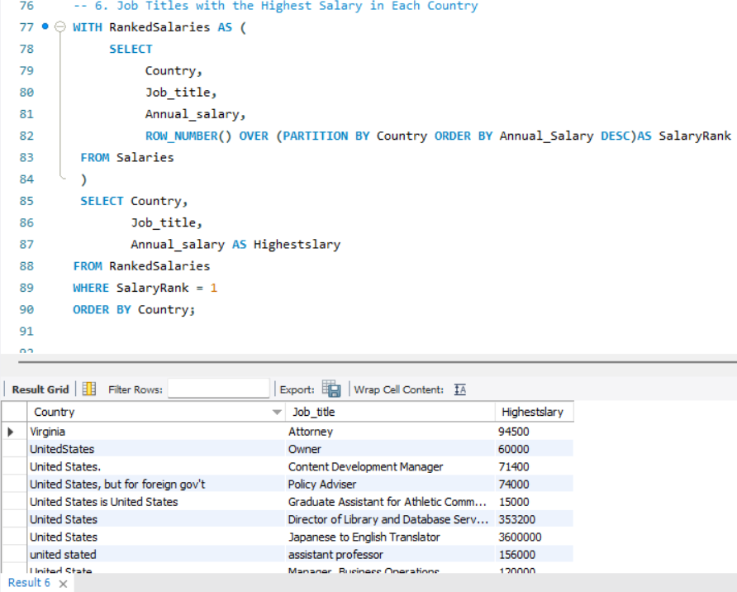
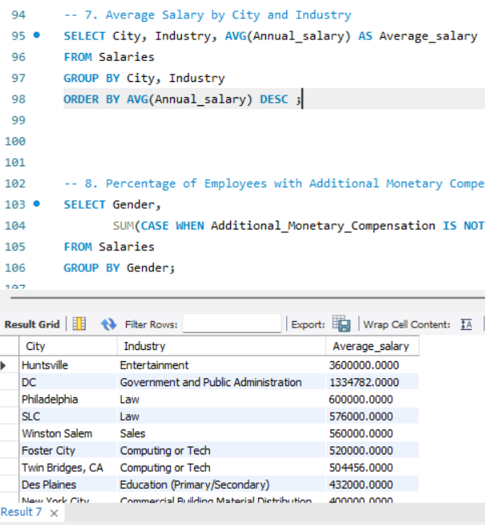

Slide 7
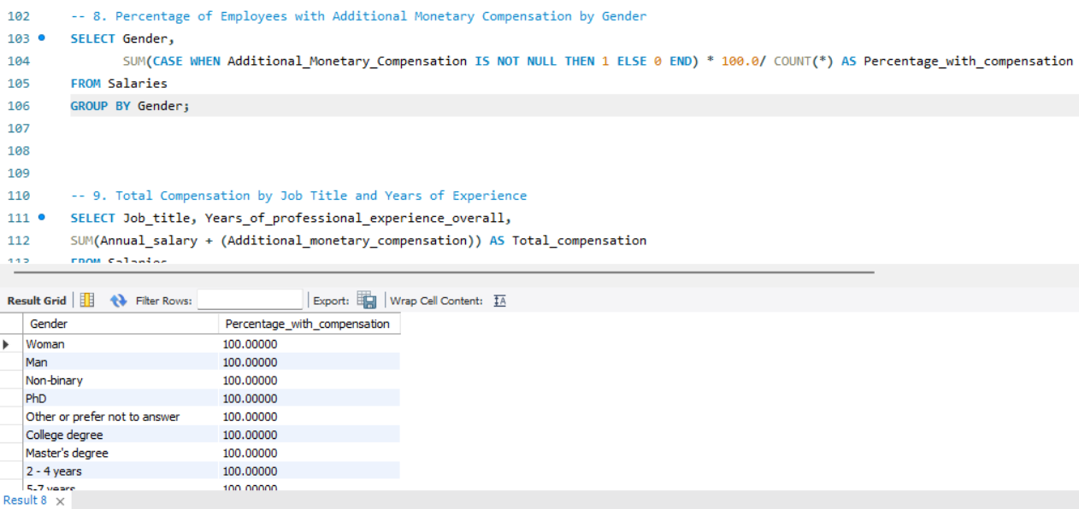

Slide 8
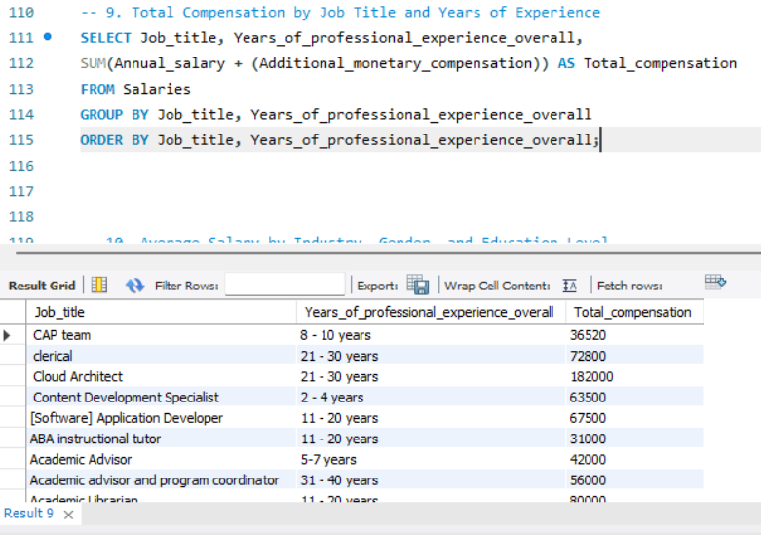
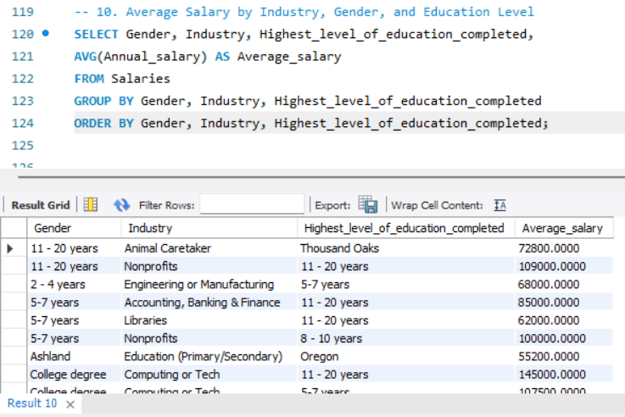

Slide 9
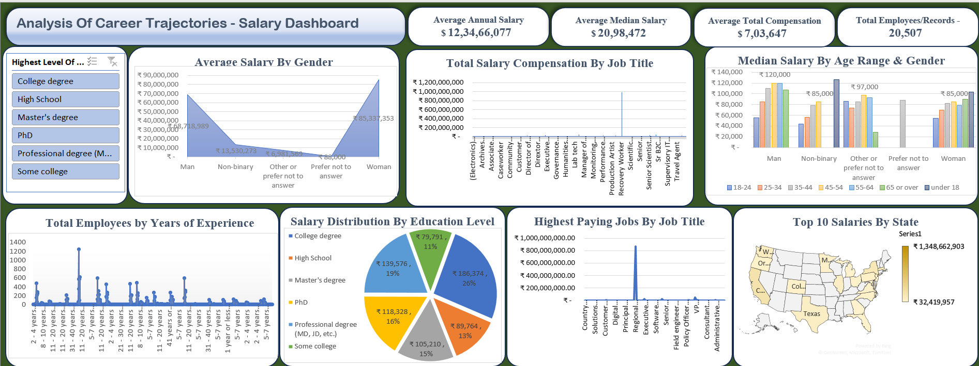
DASHBOARD

Slide 10
INSIGHTS
Education Impact: Higher education levels are strongly correlated with better salary prospects, as observed in the salary distribution analysis by educational attainment.
2. Job titles such as ‘Regional Operations & Training Manager’ demonstrate significantly higher total compensation, making them standout roles in the dataset

Slide 11
Thank You

